Slide 1






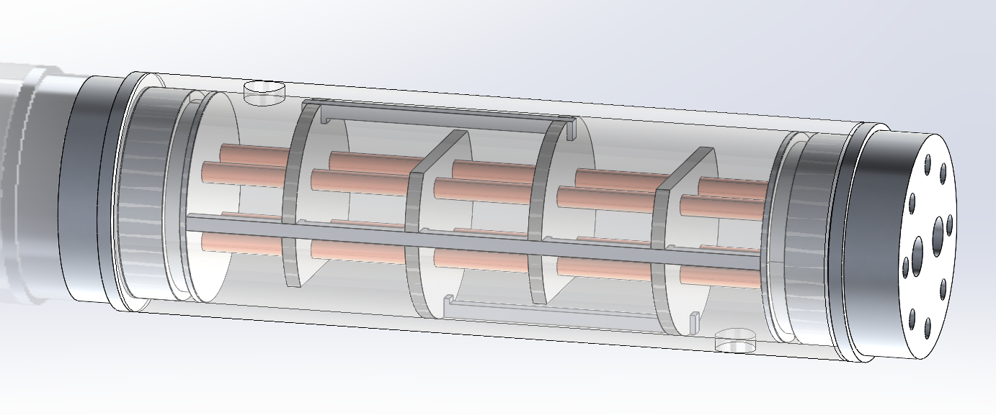
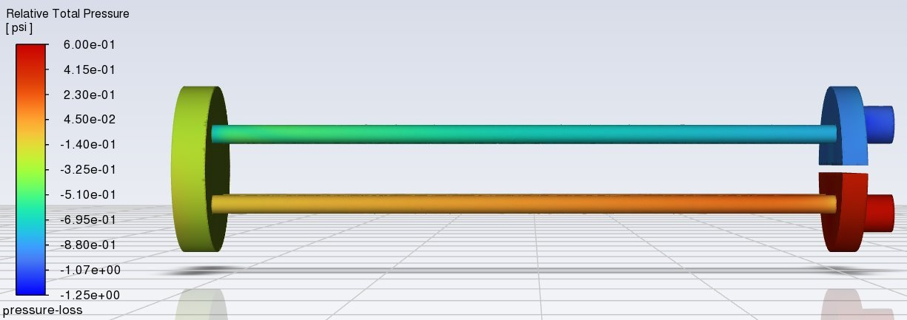
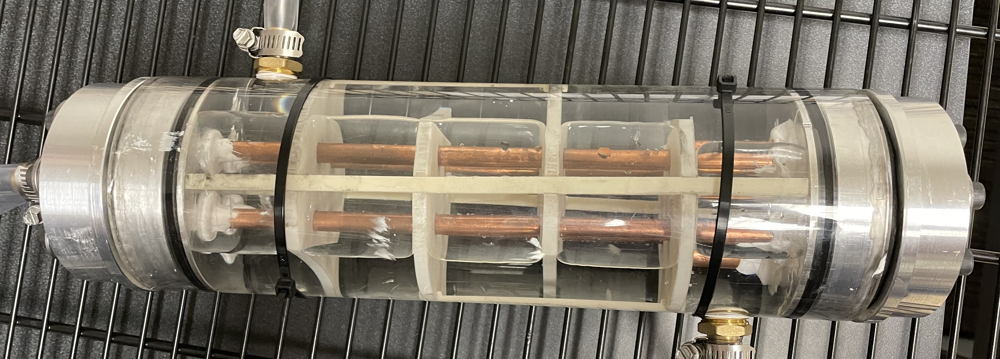




AH-64 Boeing Heat Exchanger Demonstrator
Semester: Spring 2024
Department of Mechanical Engineering, Northern Arizona University, Flagstaff, AZ 86011
Dennis Decker , Chris Mason , Uriah Whitaker , Lorenz Vios
Abstract
Methods
Conclusion
In compliance with the movement toward sustainability and carbon footprint reduction, Boeing is experimenting with a more environmentally friendly refrigerant. Consequently, the new refrigerant has a flammability of 4 on the NFPA diamond. With the pilot’s safety in mind, the new system must isolate the refrigerant from the cockpit. Boeing has decided to implement a heat exchanger to simultaneously transfer heat out of the ECS systems and isolate the refrigerant. As a design viability test for Boeing, the capstone team engaged in a design and manufacturing process for a shell and tube heat exchanger. The experimentally verified NTU method [1] was the primary means of calculating the heat transfer between an ice-water reservoir and a coolant. The expected effectiveness of the prototype is 62.3 percent which approaches the maximum allowable effectiveness given specific heat and flow rates of the fluids. The team will calculate the expected outputs (Effectiveness, Inlet/Outlet Temperatures, Total heat transfer between the fluids) and test to verify the results are within a reasonable accuracy to demonstrate the viability of a design stage for a system that utilizes the high pressure HFO-1234yf in place of the Ice-water.
Manufacturing [2]
Baffles and baffle spines were 3D printed out of PLA+
Pure copper pipes used as heat transfer material
6061 Aluminum end cap components were machined on lathe and vertical mill.
Acrylic shell was purchased, and flow bungs were threaded in
Rubber gaskets laser etched, and hand cut; NBR O-rings utilized for sealing
Testing/Monitoring
ANSYS Fluent simulations verified the allowable pressure losses of across the heat exchanger.
The ε-NTU method, utilizing experimentally determined flow rates, calculated the theoretical performance of the heat exchanger geometry [1].
Digital pressure gauges measured the static gauge pressure near the heat exchanger inlets and outlets [2].
Steady state temperature measurements were collected with K-type thermocouples connected to a Pico TC-08 Data logger. These measurements were used to calculate the maximum and actual heat transfer between the fluid loops, thus the effectiveness of the heat exchangers [3].
In conclusion, the Boeing HX team successfully met all client and team requirements. Our heat exchanger design successfully met all technical requirements set by the Boeing Company. This project also provided a more in-depth knowledge in thermal-fluid engineering. We anticipate that future endeavors involving HFO-1234yf will benefit from the lessons learned and processes established by the Boeing HX team.
References
Results
[1] T. L. BERGMAN, Fundamentals of Heat and Mass Transfer, S.l.: WILEY, 2020
[2] E. Oberg, F. Jones, and L. Holbrook, Machinery’s Handbook. New York: Industrial, 2012.
[3] R. S. Figliola and D. E. Beasley, Theory and Design for Mechanical Measurements. Hoboken, NJ: Wiley, 2011
[4] “Design and Operation of Heat Exchangers and their Networks, https://www-sciencedirect-com.libproxy.nau.edu/science/article/pii/B9780128178942000030 (accessed Sep. 14, 2023).
[5] M. Pennington, “Heat Exchanger Design Handbook,” Academia.edu, https://www.academia.edu/4715789/Heat_Exchanger_Design_Handbook (accessed Sep. 14, 2023).
[6] “The engineering toolbox,” Engineering ToolBox, https://www.engineeringtoolbox.com/index.html (accessed Sep. 17, 2023).
[7] S. Sharma et al., “Computational fluid dynamics analysis of flow patterns, pressure drop, and heat transfer coefficient in staggered and inline shell-tube heat exchangers,” Mathematical Problems in Engineering, vol. 2021, pp. 1–10, Jun. 2021. doi:10.1155/2021/6645128
Objective | Requirement | Result
Total Budget | <$6,000 | $2,248
Operation Time | =30 minutes | >30 minutes
Heat Exchanger Size | <6”x6”x18” | 4.25”x4.25”x15.5”
Heat Exchanger Seals | No leakage | No leakage
Temperature Drop | 5°C | 5.4°C
Requirements
The system must be easily transportable and have a max area of 6’’x6’’x18’’ for the liquid-to-liquid heat exchanger.
The system must operate for at least 30 minutes without melting all the ice.
The maximum pressure loss must be below 40 psi throughout the whole system to allow the pump to function properly.
Material cost of the system should be below $1,000 with a total project budget of $6,000.
The target effectiveness of the heat exchanger is at least 50%; Temperature difference must be greater than 5°C.
Acknowledgements
Technical Advisors
Michael Vogelsang Aaron Kreuter
Amanda Nemec David Willy
Figure 1. Heat Exchanger CAD Model
Figure 2. ANSYS Pressure Simulation
Figure 3. Manufactured Heat Exchanger

